Slide 1
Timesheet Training 2020

Slide 2
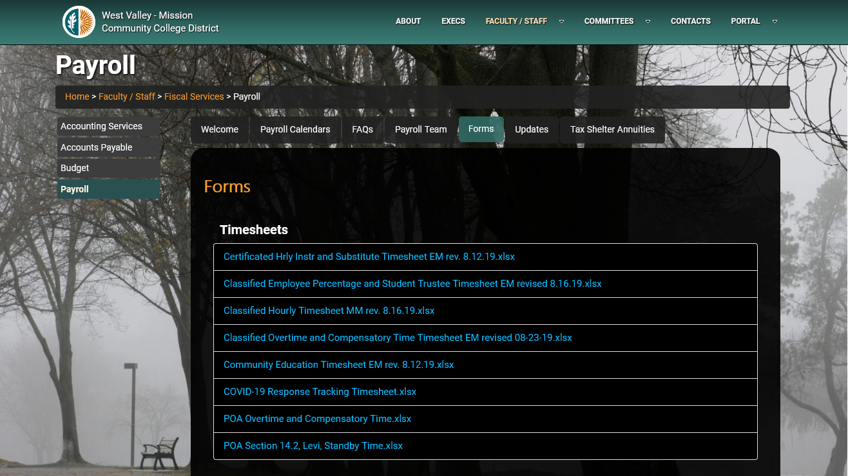
PAYROLL Timesheets
Payroll Timesheets can be obtained from the District's Payroll website.
*Never save the timesheet to your desktop, they're periodically updated.

Slide 3
Timesheets
Overtime (Classified & POA only)
Classified Hourly Percentage Employees
Certificated Hourly & Substitute (Lecture, Lab, Librarian & Counselors)
Community Education (Fee Based)

Slide 4
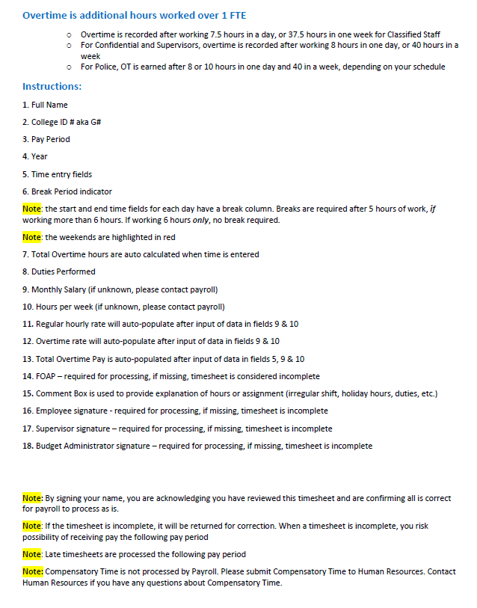
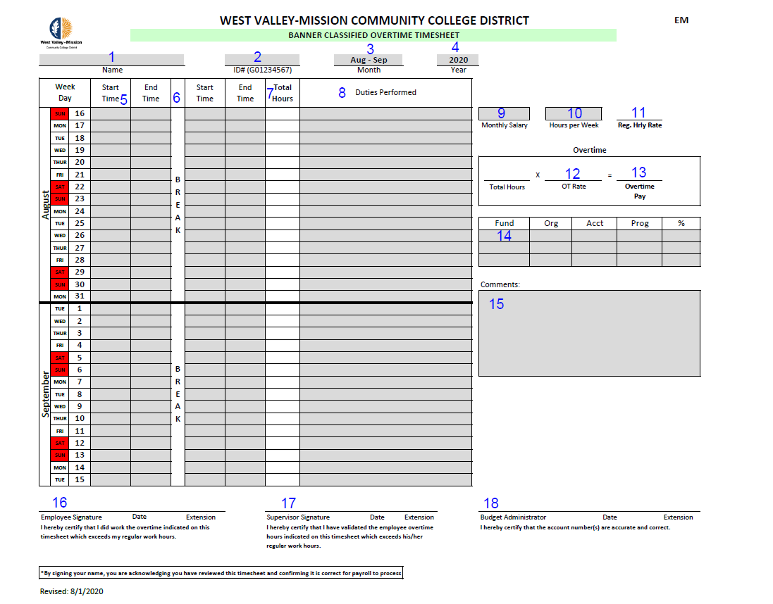
Overtime

Slide 5
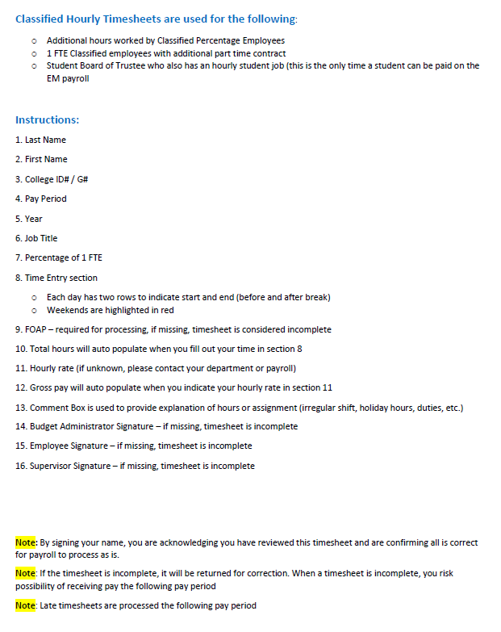
Classified Hourly EM

Slide 6
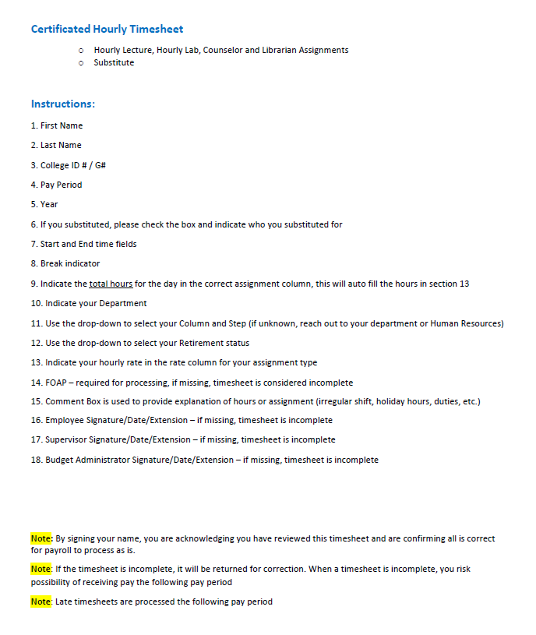
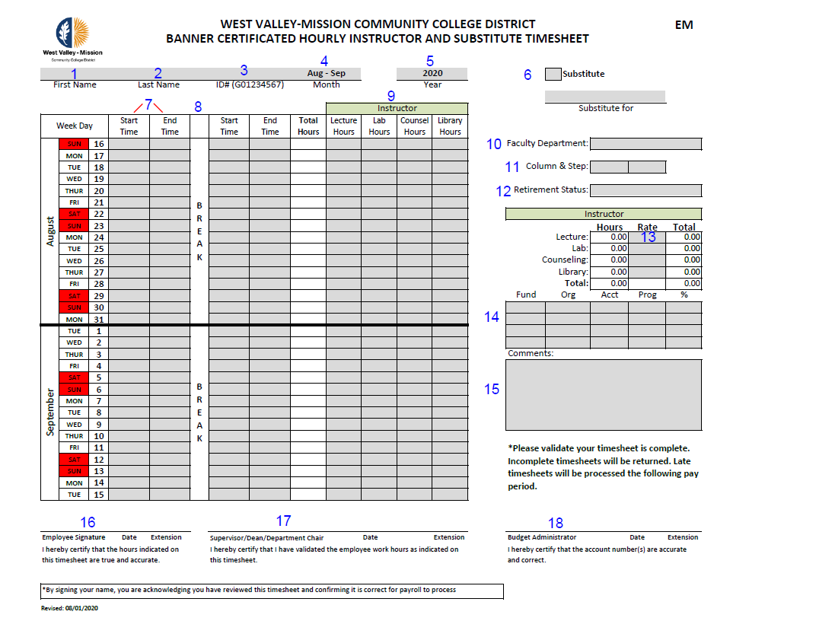
Certificated Hourly & Substitute

Slide 7
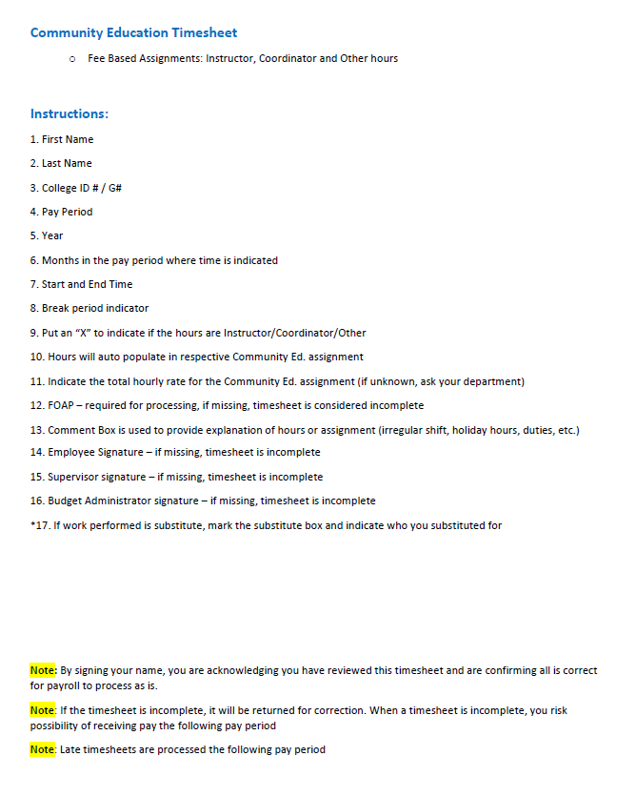
Community Education (Fee Based)

Slide 8
Required Info.
Submitting Timesheets to Payroll

Slide 9
Signatures
All signatures are required for processing a payment
If you are both the Supervisor and Budget Administrator, please sign on both lines
If you are a proxy, please sign as proxy on the appropriate line, make note on timesheet
Signatures must be an original or DocuSign

Slide 10
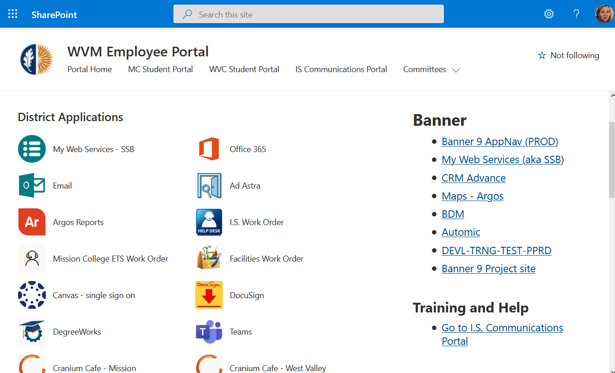
DocuSign
1. Go to the District Website
2. Select Login from the Portal drop-down menu
You will be re-directed to the Employee Portal Login
1. Click on DocuSign
You will be re-directed to the DocuSign application where you can create a legally binding electronic signature
You can upload, sign, request signatures and send your document(s) to your intended recipient(s)

Slide 11
Fund Organization Account Program (FOAP)
The FOAP must be present and valid to be processed
Upon entry, if the FOAP is invalid, the timesheet is considered incomplete
Payroll will not make changes to the FOAP unless otherwise directed

Slide 12
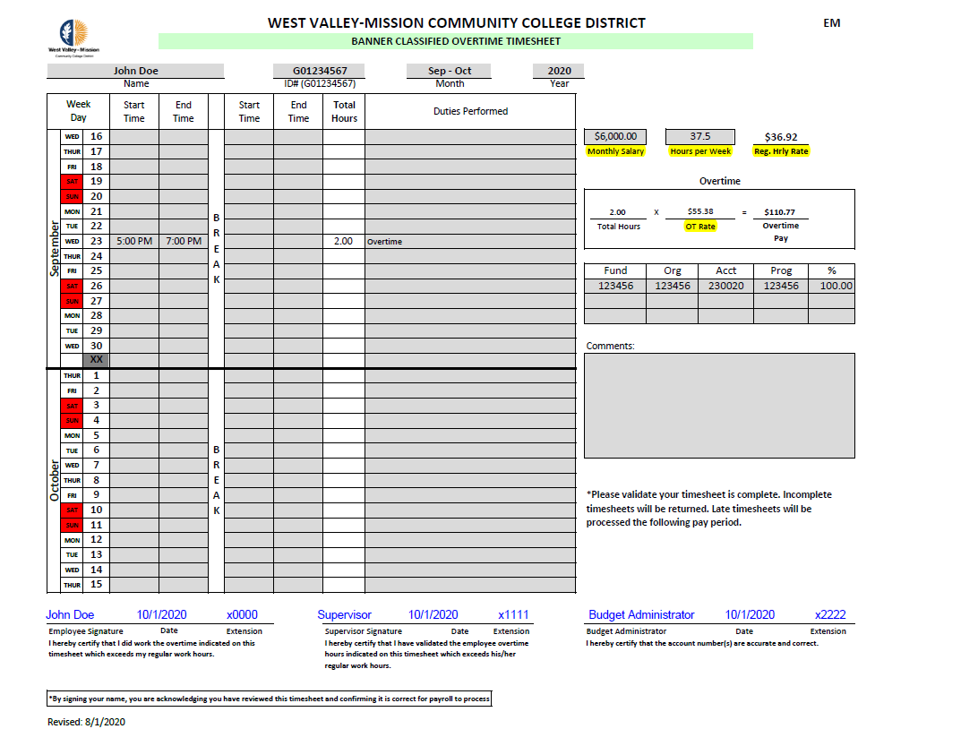
Hourly Rates
Hourly Rates must be present when submitting timesheets to payroll
If you do not know your Monthly Salary or Hours per Week to auto populate your Regular Hourly Rate for Overtime, please contact Payroll
If you are an Instructor, Counselor or Librarian, please contact the Administrative Specialist of your department, or Human Resources for your Hourly Rate

Slide 13
Red Flags
Auditing Timesheet

Slide 14
Break Periods
Please ensure your staff are taking breaks in accordance with CA Labor Law
30-minute break must be taken after working 5 hours, if working more than 6 hours
If shift is no more than 6 hours, the required 30-minute break can be waived
This rule does not apply to hourly counselors or police

Slide 15
Holiday Hours
Timesheets are flagged for hours indicated on holidays when the campuses were closed
The holiday in this example is Labor Day. Holiday hours can cause delay in payment
The holiday hours can be validated with a comment from the supervisor in the comments section.
John Doe worked on a special project remotely on the July 4th holiday. Hours are valid.

Slide 16
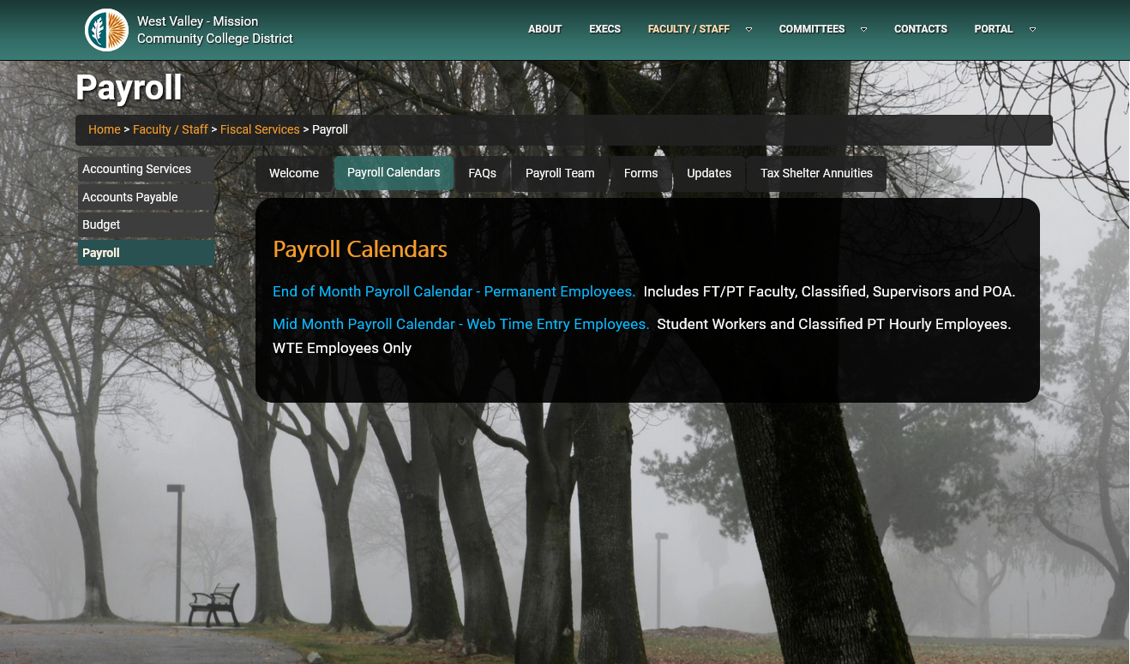

Slide 17
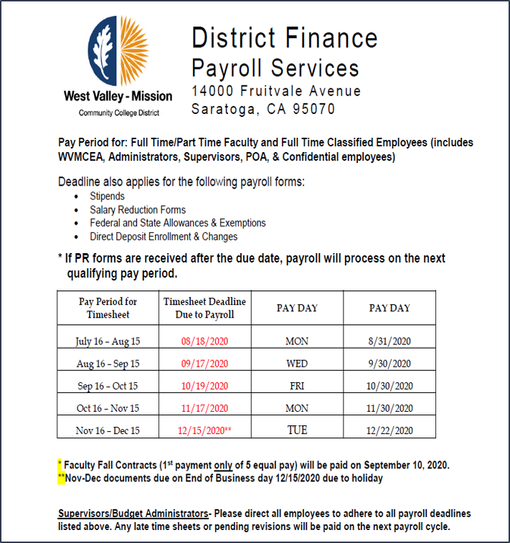
EM Payroll Calendar
Timesheet pay period is from the 16th to the 15th of the following month
Timesheet deadline is in red font on the calendar
Timesheets must be submitted by end of business day (5 pm)
Submit your completed timesheet to payroll.services@wvm.edu
This email is Payroll's virtual in-box!

Slide 18
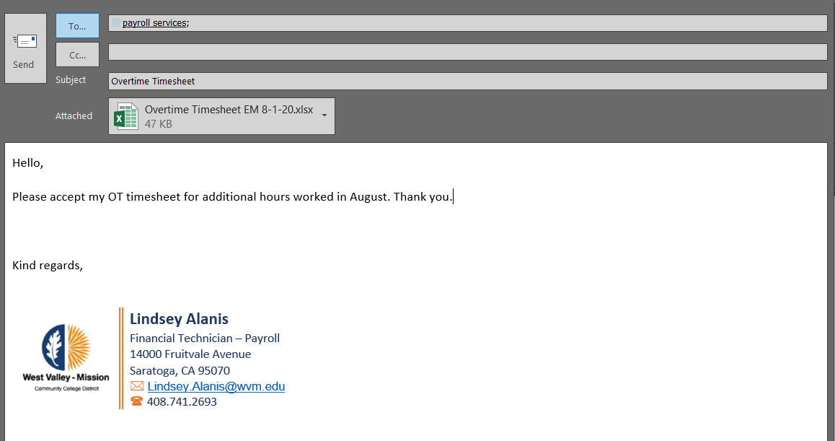
Submitting Timesheets
Submit your documents to Payroll.Services@wvm.edu
This email address is Payroll’s virtual in-box. Each member of the Payroll Team has access to this email address, ensuring your document or request is received.

Slide 19
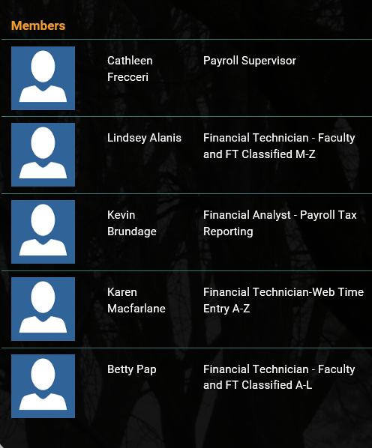
Payroll Team
Cathleen.Frecceri@wvm.edu
Lindsey.Alanis@wvm.edu
Kevin.Brundage-Sears@wvm.edu
Karen.MacFarlane@wvm.edu
Betty.Pap@wvm.edu

Slide 20
Thank you!
Any Questions?

