Slide 1
NEW HIRE PROCEDURES
SHORT TERM EMPLOYEES & STUDENT WORKERS

Slide 2
AGENDA
Overview of the hiring process through DocuSign
How to Complete the NOE and New Hire Packet in Docusign
NOE’s
Short Term NOE + Student Worker NOE
Approved NOE
Questions
Contact Information

Slide 3
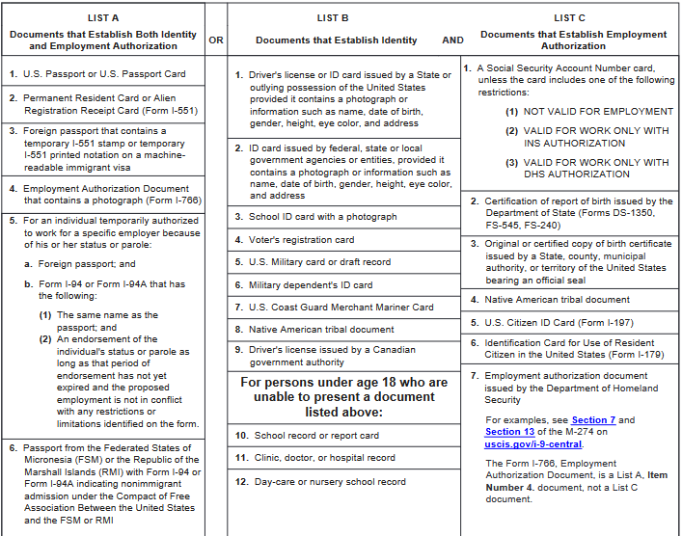
HIRING HUB/I-9 VERIFICATIONS
WEST VALLEY COLLEGE
Location: HR Office
EVERY TUES/THURS
9:00am to 1:00pm
MISSION COLLEGE
Location: SEC346
EVERY MON/TUES
9:00am to 1:00pm
PLEASE HAVE EMPLOYEE BRING DOCUMENTS TO I-9 VERIFICATION MEETING

Slide 4
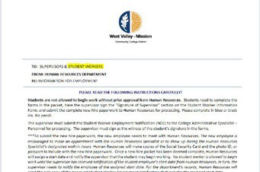
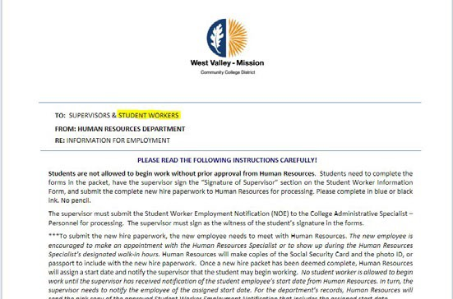
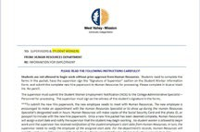
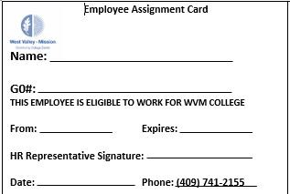
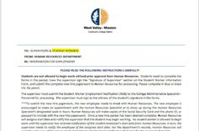
THE PROCESS – ONLY 7 STEPS
Step 1
Step 2
Step 3
Step 4
New hire meets with supervisor.
Step 7
Supervisor sends
New Hire Packet/NOE
Step 6
New hire completes packet
Step 5
Supervisor signs required forms
Welcome to West Valley- Mission Community College District!
HR verifies New Hire Packet, NOE & Completes I-9 Verification
Once documents have been approved, HR will approve the NOE Via Docusign

Slide 5
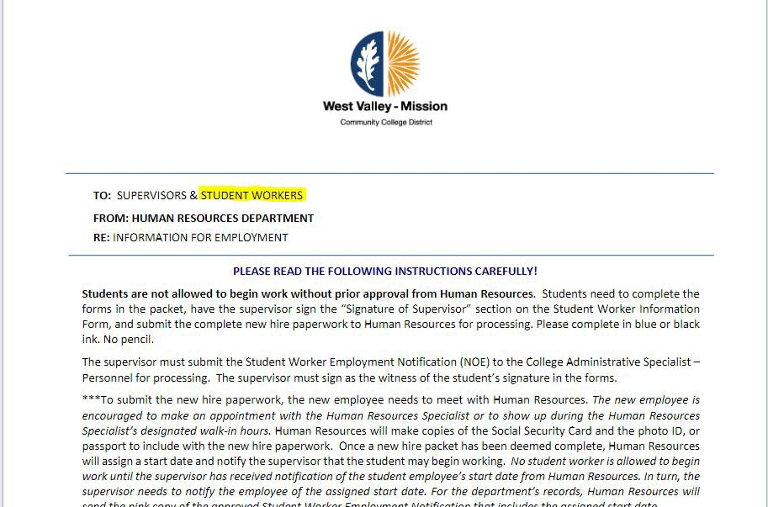
STEP 1 & 2
Supervisor meets with employee:
Provides New Hire Packet via DocuSign
Completes NOE via Docusign
Informs employee to dedicate 1-1.5 hours to complete the New Hire Packet
Summarize all required documents and information needed to complete the NHP
Provides the new employee the I-9 Verification Drop In meeting times
Reminds employee that all steps (Hire Packet, I-9 verification, TB Results and Livescan) need to be completed before they can begin working.

Slide 6
THE HIRING PROCESS VIA DOCUSIGN
THINGS TO REMEMBER
Sign into docusign and select “Templates”
Select “Shared with Me”
Select the document you want to use and click “USE”
Assign all the levels of those who need to sign and complete the file, including yourself
Click “SEND”
Once you send it, then complete it. DO NOT complete prior to clicking send as it will update the template and make it not able to be used by anyone

Slide 7
STEP 3
(NEW HIRE RESPONSIBILITIES)
New Hire Checklist
New hire schedules TB test (required) and Live Scan/ Fingerprinting (if applicable)
New hire attends one of the drop in meetings for I-9 Verification
New hire completes New Hire Packet
New hire awaits the confirmation from the Supervisor that the paperwork has been processed and they can begin working

Slide 8
STEP 4
Supervisor signs required forms on New Hire Packet via DocuSign once received from new employee. (Docusign will automatically send you the hire packet once the employee completes its)

Slide 9
REQUIRED RECIPIENTS (CONT. STEPS 4 )
Short Term NOE
Financial Analyst Initials – Account Number
Budget Administrator(s) signature
Vice Pres./Pres./ Vice. Chan./ or Designee
Student Services go to VPSS
Instruction goes to VPI
Admin goes to VP of Administrative services
Management Analyst initials
Student Worker NOE
Financial Analyst – Account Number
Budget Administrator(s) signature
Management Analyst initials (MC)
All NOE’s MUST be filled out completely with the only exception of start date.

Slide 10
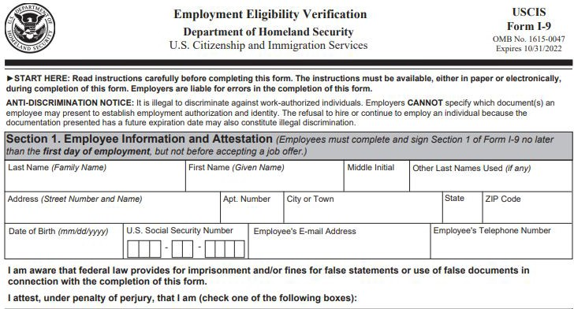
STEP 5
HR meets with employee in person to verify I-9
Documentation (This step is missed and is the number one reason that staff are not processed as soon as they can be)
New employee should have submitted:
Completed New Hire Packet
TB results & Live scan (if required)
Social Security Card

Slide 11
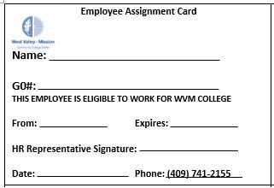
STEP 6
HR reviews NOE and NHP
Position title, duties, pay rate
NO missing required signatures
HR will provide start date via Approved NOE (Please note the approved NOE when submitted via docusign will be sent via docusign and not in an additional email.)
Supervisor may NOT start new employee unless Approved NOE has been received
No back dating or rushed NOE will be accepted. Payroll will also not be processing manual checks for NOE not submitted on time

Slide 12
STEP 7
Welcome to West Valley-Mission Community College District!

Slide 13
THINGS TO REMEMBER
*Send ALL items for processing to HR Assistant at hr.assistant@wvm.edu
*If an employee wants to see their own doctor, the Workers Comp documentation needs to be signed by the Physician
*Overtime is not allowed for student workers
*Forms that are not completed will not be accepted and docusign file will be declined.
* Hit your Deadline's - We want to make sure employee's get processed asap. The deadline for all hourly employees if you want them to start on 1st day of semester:
Winter - December 1st (January 1st Start Date)
Spring - January 2nd (January 20th Start Date)
Summer - May 1st (May 20th Start Date)
Fall - August 1st (August 20th Start Date)
*Anything submitted passed the above deadlines will be processed with a later semester start date.
*During off-peak periods (outside the start of a semester) turn around time should be 4-5 business days from the time ALL documents have been received by HR. (This includes the I-9 verification and hire packets)

Slide 14
QUESTIONS

Slide 15
CONTACT INFORMATION
hr.assistant@wvm.edu

